Slide 1
3 DISK Flickering Condition

Slide 2


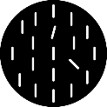

In each frame, 3 disks and a red fixation dot will be presented
In each trial, in the second and the last frame, multiple bars will be presented on the disk
cue frame
The second frame is called cue frame, and the last frame is called probe frame
In the middle disk of the cue frame, there will be two tilted bars, one in 15◦ (target) and the other in 45◦(distractor)
In the middle disk of the probe frame, one bar will be tilted in 15◦(target)
Each bar can be tilted either in clockwise or counter-clockwise manner from upward
Your task is to detect either the target bars (15◦ tilted bars) in cue and probe frames are tilted in the same direction or not
You have to ignore the 45◦(distractor) bar in the cue frame
If both are tilted in a same direction (both clockwise or counter-clockwise) press the left button, the right button for the different directions
probe frame
t
Continue …

Slide 3
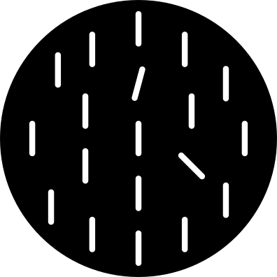
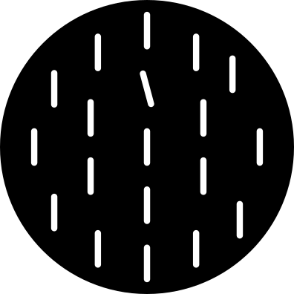
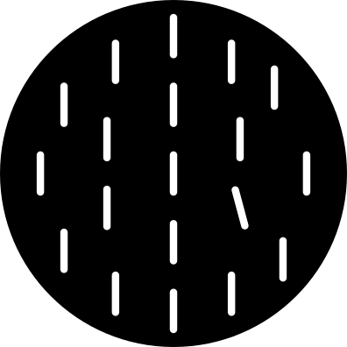
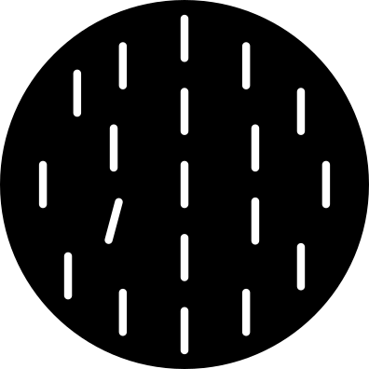
There are three possible positions for the tilted bars (red circles)
In the cue frame, the target bar (15◦) and the distractor bar (45◦) are presented in the two different positions
In the probe frame, the target bar (15◦) can be presented in any of three positions, therefore, it will be in the same position as cue-target position, cue-distractor position, or the third position
ex. Cue frame and Probe frames
But the target positions are not important, your task is to detect whether target bars in cue and probe frames are tilted in a same direction or not
If both are tilted in a same direction (both clockwise or counter-clockwise) press the left button, the right button for the different directions
Cue frame
Target →
← distractor
Probe frame
Cue frame
Probe frame
Cue frame
Probe frame
Target →
or
or
Target →
← Target
Same position as cue-target
Same position as cue-distractor
The third position
Same direction: left button (arrow)
Different direction: right button (arrow)

Slide 4
Example
Task: Report the Same (left) / Opposite (right) tilt of the target bar (15◦) in the middle disk
Please fixate your eyes on the red fixation dot all the time

Slide 5
3 DISK NON-RET CONDITION

Slide 6
cue frame
Please fixate your eyes on the red fixation dot all the time
Your task is the same, except there will be three disks
Tilted bars will be always presented in the middle disk
Your task is to detect either the target bars (15◦ tilted bars) in cue and probe frames are tilted in the same direction (left button) or not (right button)
Again, you have to ignore the 45◦(distractor) bar in the cue frame
probe frame
t

Slide 7
Example
Task: Report the Same (left) / Opposite (right) tilt of the target bar (15◦) in the middle disk
Please fixate your eyes on the red fixation dot all the time

Slide 8
3 DISK RET CONDITION

Slide 9
cue frame
Please fixate your eyes on the red fixation dot all the time
Your task is the same, except the tilted bars will be presented in different disks
In the cue frame, tilted bars will be presented in the left most disk
In the probe frame, tilted bars will be presented in the middle disk
Thus, the tilted bars are always presented in the disk on the left side of the fixation dot
Your task is to detect either the target bars (15◦ tilted bars) in cue and probe frames are tilted in the same direction (left button) or not (right button)
Again, you have to ignore the 45◦(distractor) bar in the cue frame
probe frame
t

Slide 10
Example
Task: Report the Same (left) / Opposite (right) tilt of the target bar (15◦) in the target disks
The cue frame’s target disk is the left most disk and the probe frame’s target disk is the middle disk
Please fixate your eyes on the red fixation dot all the time

Slide 11
Additional question after the experiment
1. Were the disks flickering (on/off) or moving left-and-right as a group?
(1) each disk was flickering on and off --------------------------------- (5) three disks were moving left-and-right as a group

Slide 12
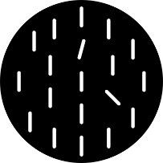
1 DISK CONDITION

Slide 13
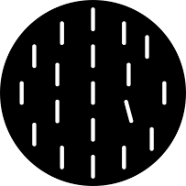
In each frame, 1 disk will be presented in the middle of the screen, and you will see 5 frames in each trial
In each trial, in the second and the last frame, multiple bars will be presented on the disk as shown below
probe frame
The second frame is called cue frame, and the last frame is called probe frame
In the cue frame, there will be two tilted bars, one in 15◦ (target) and the other in 45◦(distractor)
In the probe frame, one bar will be tilted in 15◦(target)
Each bar can be tilted either in clockwise or counter-clockwise manner from upward
Your task is to detect either the target bars (15◦ tilted bars) in cue and probe frames are tilted in the same direction or not
You have to ignore the 45◦(distractor) bar in the cue frame
If both are tilted in a same direction (both clockwise or counter-clockwise) press the left button, the right button for the different directions
cue frame
t
Continue …

Slide 14
Example
Task: Report if the 15◦ tilted bars are tilted in the same direction (left button) or the opposite direction (right button)
Please fixate your eyes on the red fixation dot all the time

Slide 15
2 DISK CONDITION

Slide 16
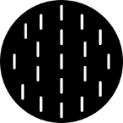
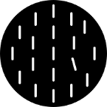
cue frame
Please fixate your eyes on the red fixation dot all the time
Your task is the same, except there will be two disks
Tilted bars will be always presented in the left disk
Your task is to detect either the target bars (15◦ tilted bars) in cue and probe frames are tilted in the same direction (left button) or not (right button)
Again, you have to ignore the 45◦(distractor) bar in the cue frame
probe frame
t

Slide 17
Example
Task: Report the Same (left) / Opposite (right) tilt of the target bar (15◦) in the left disk
Please fixate your eyes on the red fixation dot all the time

